Slide 1
Bakery Shop
Brandon Taylor
Renato Stoco

Slide 2
Bakery Shop
Why this dataset?
What are our tasks?
What benefits from this analysis?
Notes:
Why this dataset?
Reflected shopping cart problem
Large set of transactional data
What are our tasks?
Mine association rules
Attempt to cluster customer data
What benefits from this analysis?
Marketing information can be collected and used to improve sales

Slide 3
Bakery Shop
Dataset Sizes
5000, 20000, and 75000 transactions
Dataset items
40 baked goods and 10 beverages

Slide 4
Bakery Shop
(0,'Chocolate','Cake',8.95,'Food');
.
.
almond bearclaw
blueberry danish
lemonade
raspberry lemonade
orange juice
green tea
bottled water
hot coffee
chocolate coffee
frap
soda
espresso
chocolate cake
lemon cake
casino cake
opera cake
strawberry cake
truffle cake
chocolate eclair
coffee eclair
vanilla eclair
napoleon cake
.
.
.
sub-type
type
product id
Data comes in two forms
Sparse csv
0,1,0,1,0,0,0,0,0,0,0,0,0,0,0,0,0,0,0,1,0,1,0,0,0,1,0,0,0,0,0,0,0,0,0,0,0,0,0,0,0,0,0,0,0,0,0,0,0,0
Definitive csv
1, 3, 19, 21, 25

Slide 5
Bakery Shop
Implementing Apriori in Python
using methods described in
Machine Learning in Action
by Peter Harrington
Support: 0.05
Confidence: 0.6

Slide 6
Bakery Shop
Round 1: Raw Data
No association rules produced

Slide 7
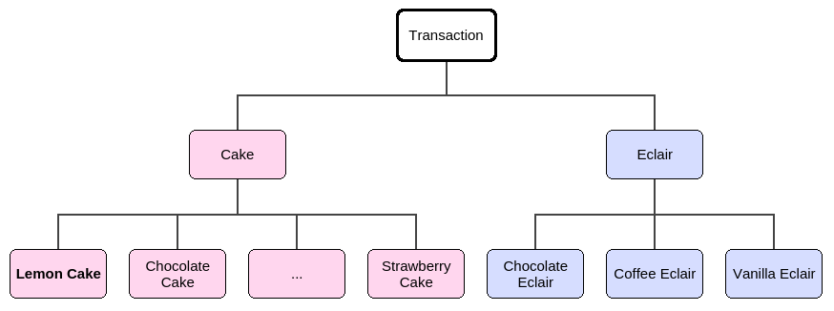
Bakery Shop
Round 2: Binning by product type
(9,'Napoleon','Cake',13.49,'Food') (10,'Almond','Tart',3.75,'Food') (11,'Apple','Pie',5.25,'Food') (20,'Pecan','Tart',3.75,'Food') (21,'Ganache','Cookie',1.15,'Food')
(40,'Lemon','Lemonade',3.25,'Drink'); (41,'Raspberry','Lemonade',3.25,'Drink'); (45,'Hot','Coffee',2.15,'Drink'); (46,'Chocolate','Coffee',2.45,'Drink');
18 products instead of 50
type
sub-type

Slide 8
Bakery Shop
Results: Binning by product type
5000 receipts
['frap'] --> ['tart'] conf: 0.7220
['bottled water'] --> ['tart'] conf: 0.7227
['croissant'] --> ['tart'] conf: 0.6059
['danish'] --> ['tart'] conf: 0.7151
20000 receipts
['frap'] --> ['tart'] conf: 0.7348
['bottled water'] --> ['tart'] conf: 0.7297
['danish'] --> ['tart'] conf: 0.7041
['espresso'] --> ['tart'] conf: 0.710
75000 receipts
['frap'] --> ['tart'] conf: 0.7247
['bottled water'] --> ['tart'] conf: 0.7347
['danish'] --> ['tart'] conf: 0.7048
Nothing but tarts..

Slide 9
Bakery Shop
Round 3: Binning by beverage type as well
2 types of beverages instead of 10

Slide 10
Bakery Shop
Results: Binning by product type
5000 receipts
['danish'] --> ['tart'] conf: 0.7151
['croissant'] --> ['tart'] conf: 0.6059
20000 receipts
['danish'] --> ['tart'] conf: 0.7041
75000 receipts
['danish'] --> ['tart'] conf: 0.7048
Less results,
People really like tarts..

Slide 11
Bakery Shop
Round 4: Removing tart binnings
(10,'Almond','Tart',3.75,'Food') (12,'Apple','Tart',3.25,'Food') (13,'Apricot','Tart',3.25,'Food') (14,'Berry','Tart',3.25,'Food') (15,'Blackberry','Tart',3.25,'Food') (16,'Blueberry','Tart',3.25,'Food') (17,'Chocolate','Tart',3.75,'Food') (18,'Cherry','Tart',3.25,'Food') (19,'Lemon','Tart',3.25,'Food') (20,'Pecan','Tart',3.75,'Food')
Adding 9 unique products to the data

Slide 12
Bakery Shop
Results: Binning by product type
5000 receipts
['Cherry tart'] --> ['cake'] conf: 0.6760
['Cherry tart'] --> ['danish'] conf: 0.6152
['Blueberry tart'] --> ['croissant'] conf: 0.6619
20000 receipts
['Lemon tart'] --> ['cake'] conf: 0.6813
['Cherry tart'] --> ['cake'] conf: 0.6526
['Berry tart'] --> ['cold beverage'] conf: 0.6032
['Cherry tart'] --> ['danish'] conf: 0.6257
['Blueberry tart'] --> ['croissant'] conf: 0.6084
75000 receipts
['Lemon tart'] --> ['cake'] conf: 0.6824
['Cherry tart'] --> ['cake'] conf: 0.6539
['Berry tart'] --> ['cold beverage'] conf: 0.6020
['Cherry tart'] --> ['danish'] conf: 0.6201
['Blueberry tart'] --> ['croissant'] conf: 0.6333

Slide 13
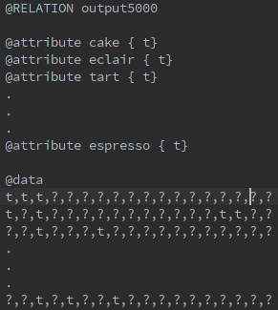
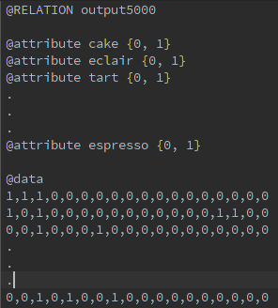

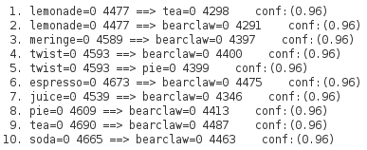
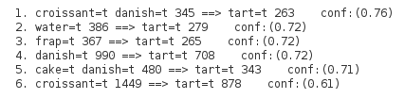
Wrong format
Right format

Slide 14
Bakery Shop: Weka
Confirmed results from Python code
Decided to try out some clustering techniques

Slide 15
Bakery Shop: Weka
Clustering using Weka:
Using Clope Algorithm, with repulsion: 1.2
Hierarchical Algorithms too expensive

Slide 16
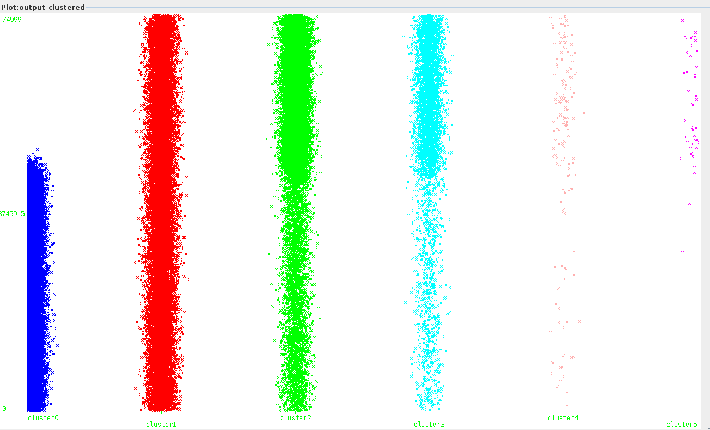
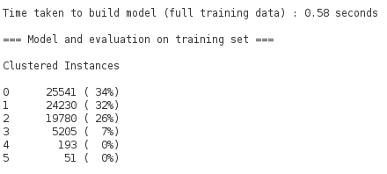
Clusters Generated by CLOPE
75000 transactions
Transactions
Clusters

Slide 17
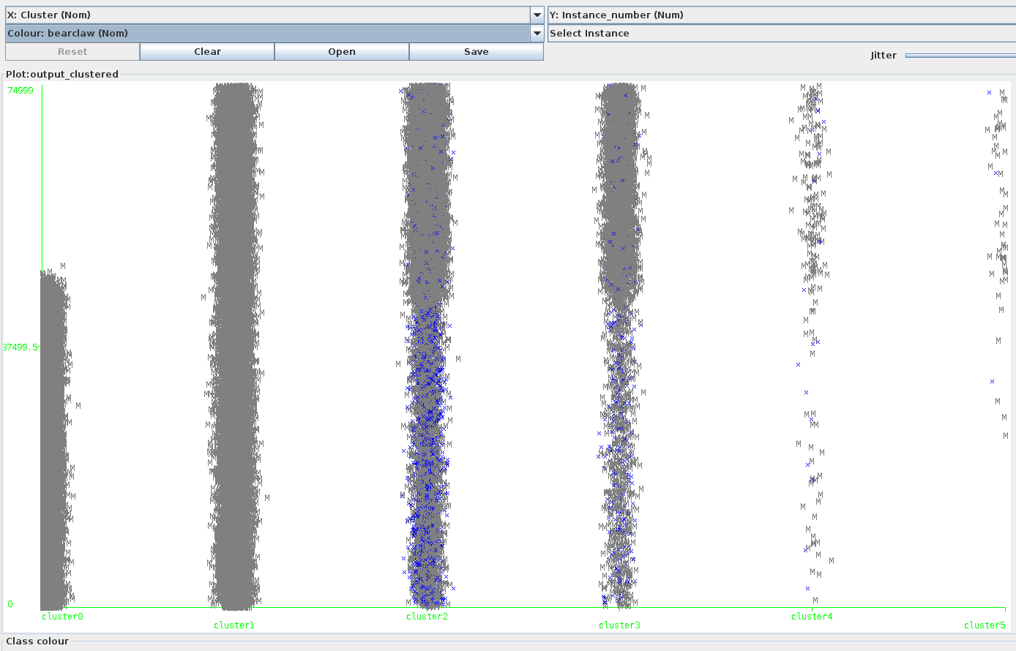
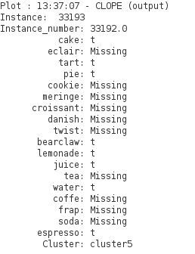
Bakery Shop: Weka
Clusters Generated by CLOPE
Focus: Bearclaws

Slide 18
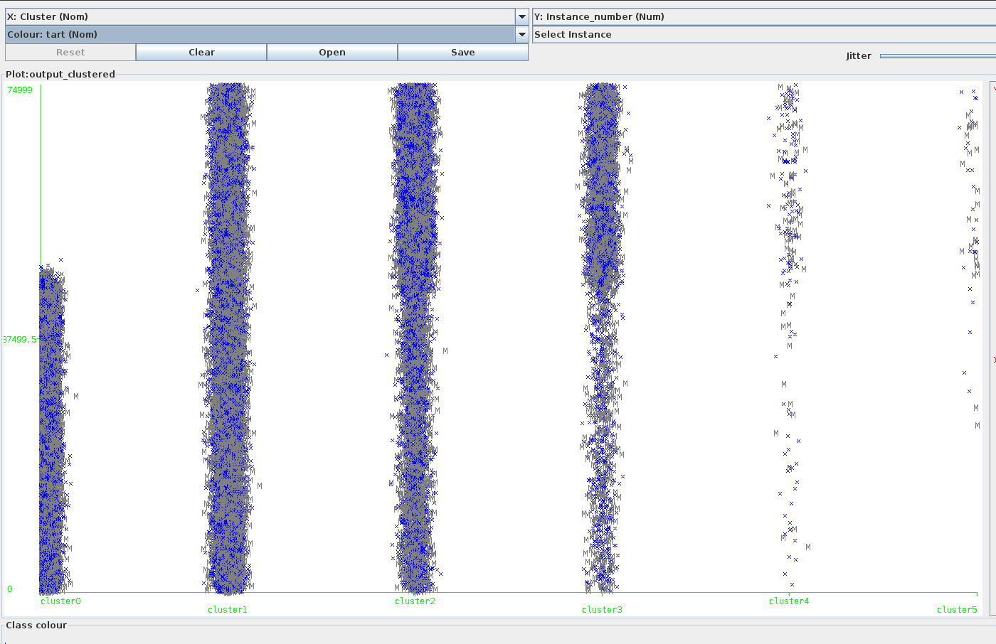
Bakery Shop: Weka
Clusters Generated by CLOPE
Focus: Tarts

Slide 19
Bakery Shop: Weka
Clusters Generated by CLOPE
Focus: Espresso

Slide 20
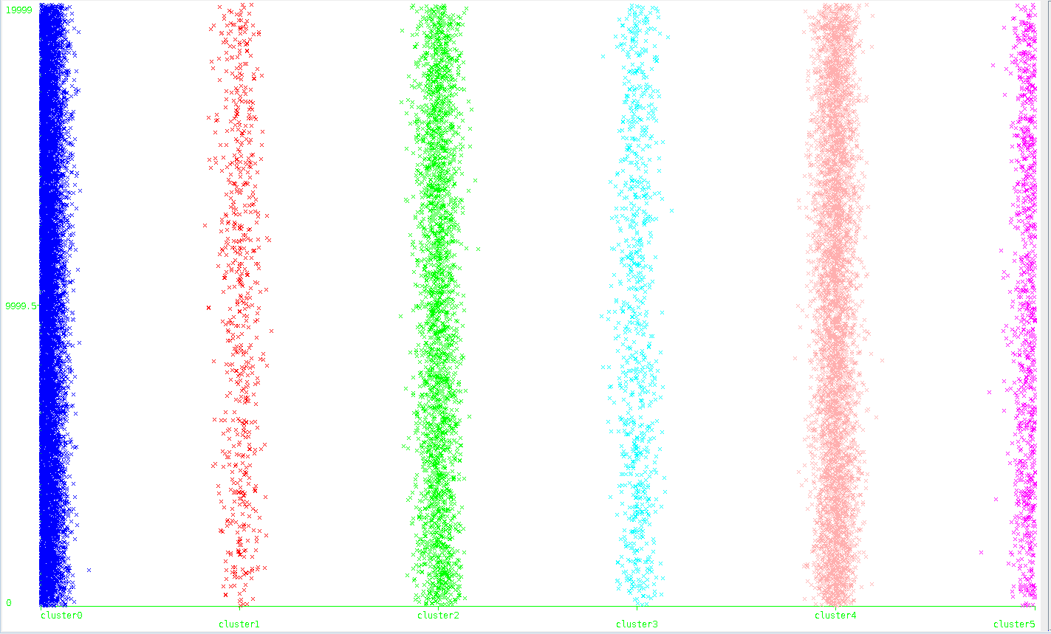
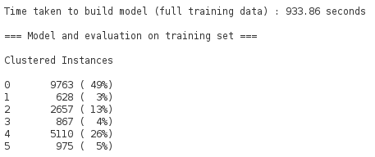
Clusters Generated by Hierarchical
20000 transactions
Transactions
Clusters

Slide 21
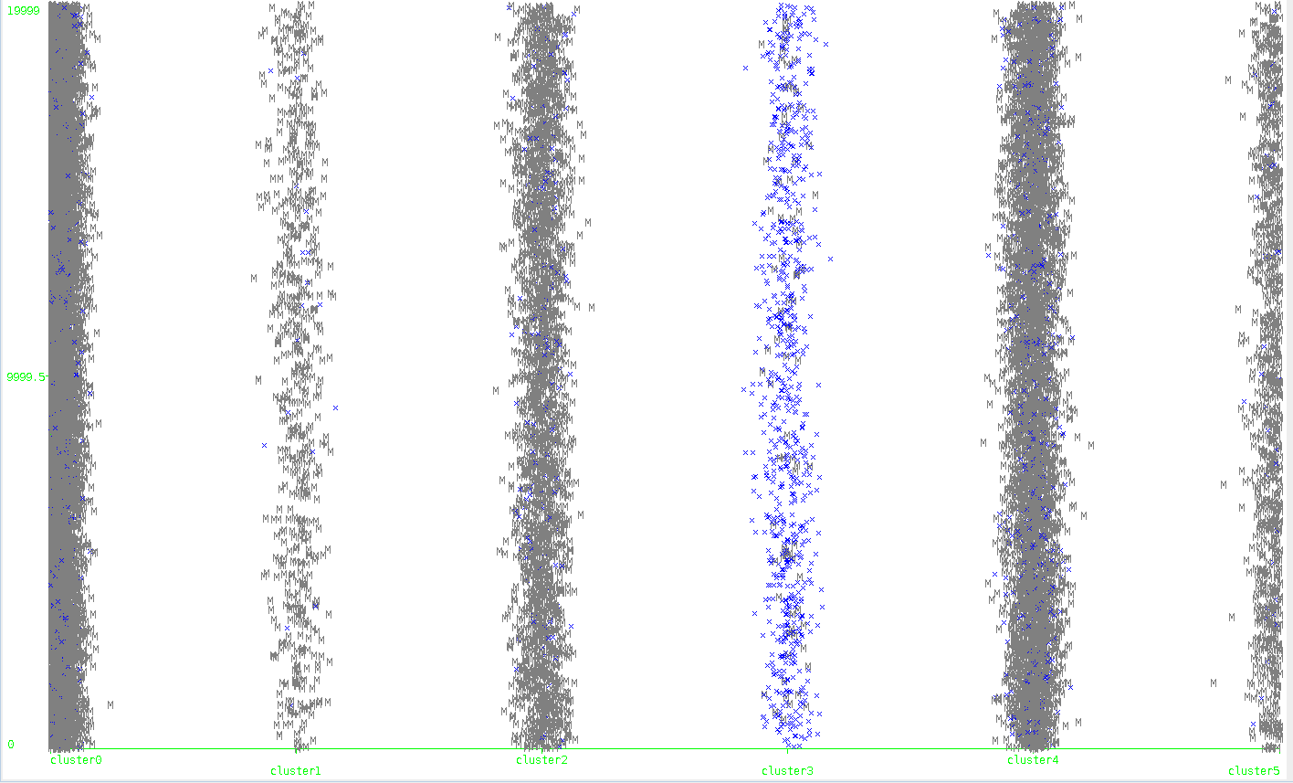
Clusters Generated by Hierarchical
Focus: Lemonade
Transactions
Clusters

Slide 22
Bakery Shop: Weka
Extracted Information
Cluster 0 | Cluster 1 | Cluster 2 | Cluster 3 | Cluster 4 | Cluster 5
Cake | Cake | Cake | Cake | ---------------- | ----------------
---------------- | ---------------- | ---------------- | Eclair | ---------------- | ----------------
Tart | Tart | Tart | Tart | Tart | ----------------
---------------- | ---------------- | ---------------- | Pie | ---------------- | ----------------
Cookie | Cookie | Cookie | Cookie | ---------------- | ----------------
Danish | ---------------- | Danish | ---------------- | ---------------- | ----------------
Lemonade | ---------------- | Lemonade | ---------------- | ---------------- | Lemonade

Slide 23
Bakery Shop: Weka
Extracted Information
Cluster 0 | Cluster 1 | Cluster 2 | Cluster 3 | Cluster 4 | Cluster 5
Cake | Cake | Cake | Cake | Tart | Tart
Tart | Tart | Tart | Eclair | Twist | Lemonade
Cookie | Cookie | Cookie | Tart | Water | Water
Danish | Juice | Meringue | Pie | Espresso | Espresso
Lemonade | End | Danish | Twist | End | End
Coffee |  | Bearclaw | Juice
End

Slide 24
Bakery Shop: Weka
Filtered Information
CLOPE: potential customer groups based on the clusters
Hierarchical Cluster: potential customer groups based on the clusters
Potential Customer 1 | Potential Customer 4 | Potential Customer 5
Cake | Tart | Tart
Tart | Twist | Lemonade
Cookie | Water | Water
Juice | Espresso | Espresso
Potential Customer 1 | Potential Customer 2 | Potential Customer 3 | Potential Customer 5
Croissant | Tart | Cookie | Eclair
Danish | Cookie | Lemonade | Pie
Juice | Croissant | Tea | Twist
 | Coffee |  | Coffee

Slide 25
Bakery Shop
Future Work
Find a way to run Hierarchical clustering on 75,000 transactions
Conclusion
Data mining techniques can lead to drawing predictions about customer behavior
Knowledge about customer behavior can lead to new marketing techniques

Slide 26
Bakery Shop
Questions?

